Slide 1

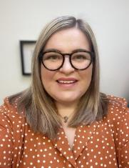
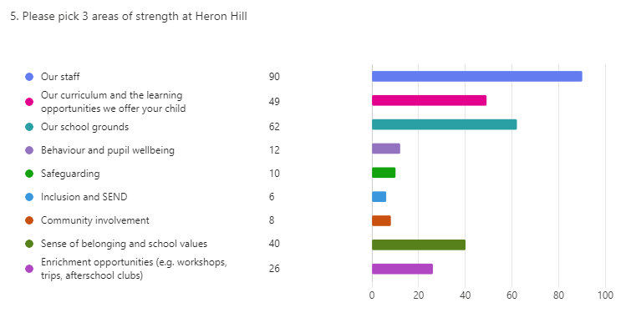
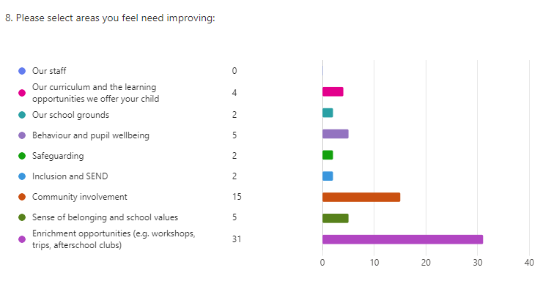
Whole-school newsletter -
Week beginning 9th December 2024
MESSAGE FROM THE HEADTEACHER
The countdown to Christmas is well and truly on with only 7 school days remaining after
today and a lot of Christmas events planned for us to enjoy. I am particularly looking
forward to our services in the Parish Church and will remember to pack my
tissues as the sound of our pupils singing never fails to bring on a tear or two!
This week’s newsletter includes a summary of our recent parent/carer feedback survey.
Thank you to the 101 people who responded to this – a great sample of responses for us to consider as a school. There were so many positive, personalised comments relating to a number of elements of life at Heron Hill. Reading repeated recognitions of how skilled, kind and hardworking our staff are was particularly pleasing. The team at Heron Hill are fantastic and I am blessed to be working alongside them each day.
Thank you for your continued support. Mrs Middleton
PARENT AND CARER FEEDBACK
100% of parents agree or strongly agree that leaders (including the headteacher) are approachable and helpful; their opinions, ideas or concerns are listened to and valued.
99% of parents agree or strongly agree that their child is happy at our school and enjoys being part of Heron Hill.
100% of parents agree or strongly agree that school communicates well with parents and carers.
4.77 average star rating
(80% of parents surveyed rated us 5 stars!)
86% of parents felt they had no suggestions for areas of provision that we could improve on.
- RESPECT - RESPONSIBILITY - RELATIONSHIPS -

Slide 2



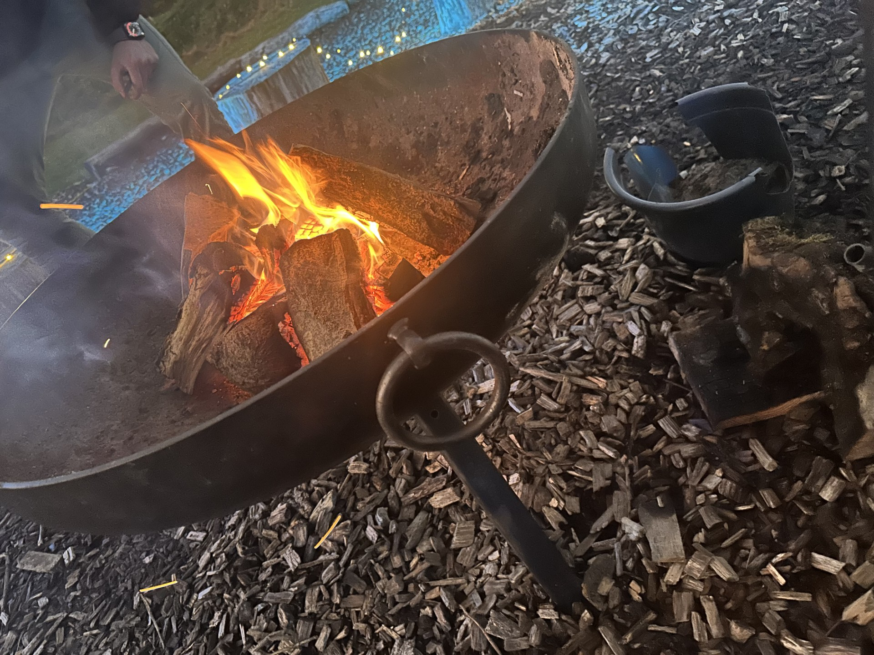
Y2’S CHRISTMAS PRODUCTION
Last week our Y2 cohort put on a spectacular display of drama and singing in their twist on the traditional nativity, ‘The Fleece Force’. It was fantastic to see so many visitors in school at each of the performances, championing the children and encouraging them to sing their little hearts out. I am sure you will all agree we were well and truly entertained!
Well done to the whole Y2 team of pupils and staff for their hard work and efforts in producing this play.
As a result of the generosity of their audience, Y2 have raised a grand total £148.20 for our nominated charities: New Beginnings, North West Air Ambulance, St John’s Hospice and Stand By Me/Open Arms Kenya.
Donations will also be collected at our forthcoming church services. I look forward to sharing our grand charity total with you in my final newsletter next week.
HANDWRITING AND PRESENTATION PRAISE
We continue to celebrate achievements, progress and effort in all things presentation during our weekly headteacher assemblies. This week, the children below have been praised for their super efforts. Well done! ☺
Class: | Pupil:
Y1 Angletarn | Oscar
Y1 Whinlatter | George
Y2 Outerside | Eliza
Y2 Yewbarrow | Amber
Y3 Kentmere | Kamogelo
Y3 Glaramara | Bobby
Y4 Thornthwaite | Kai
Y4 Blencathra | Jax
Y5 Fairfield | Henry
Y5 Catstycam | Chase
Y6 Helvellyn | Sam
Y6 Scafell | Josie
CAROLS AROUND THE CAMPFIRE
Thank you to all of the family
members who joined us for Year 1’s
first-ever ‘Carols Around the
Campfire’ on Monday evening. This
was a joyous event for all involved
and a great way to kickstart our final two weeks of term.
I would like to say a huge well done to the Y1 team for preparing the children so well and a huge thank you to everyone who supported in preparing the campfire for our performers.
This was another heartwarming example of our community and experiences beyond the curriculum being an important part of the Heron Hill way.
- RESPECT - RESPONSIBILITY - RELATIONSHIPS -

Slide 3




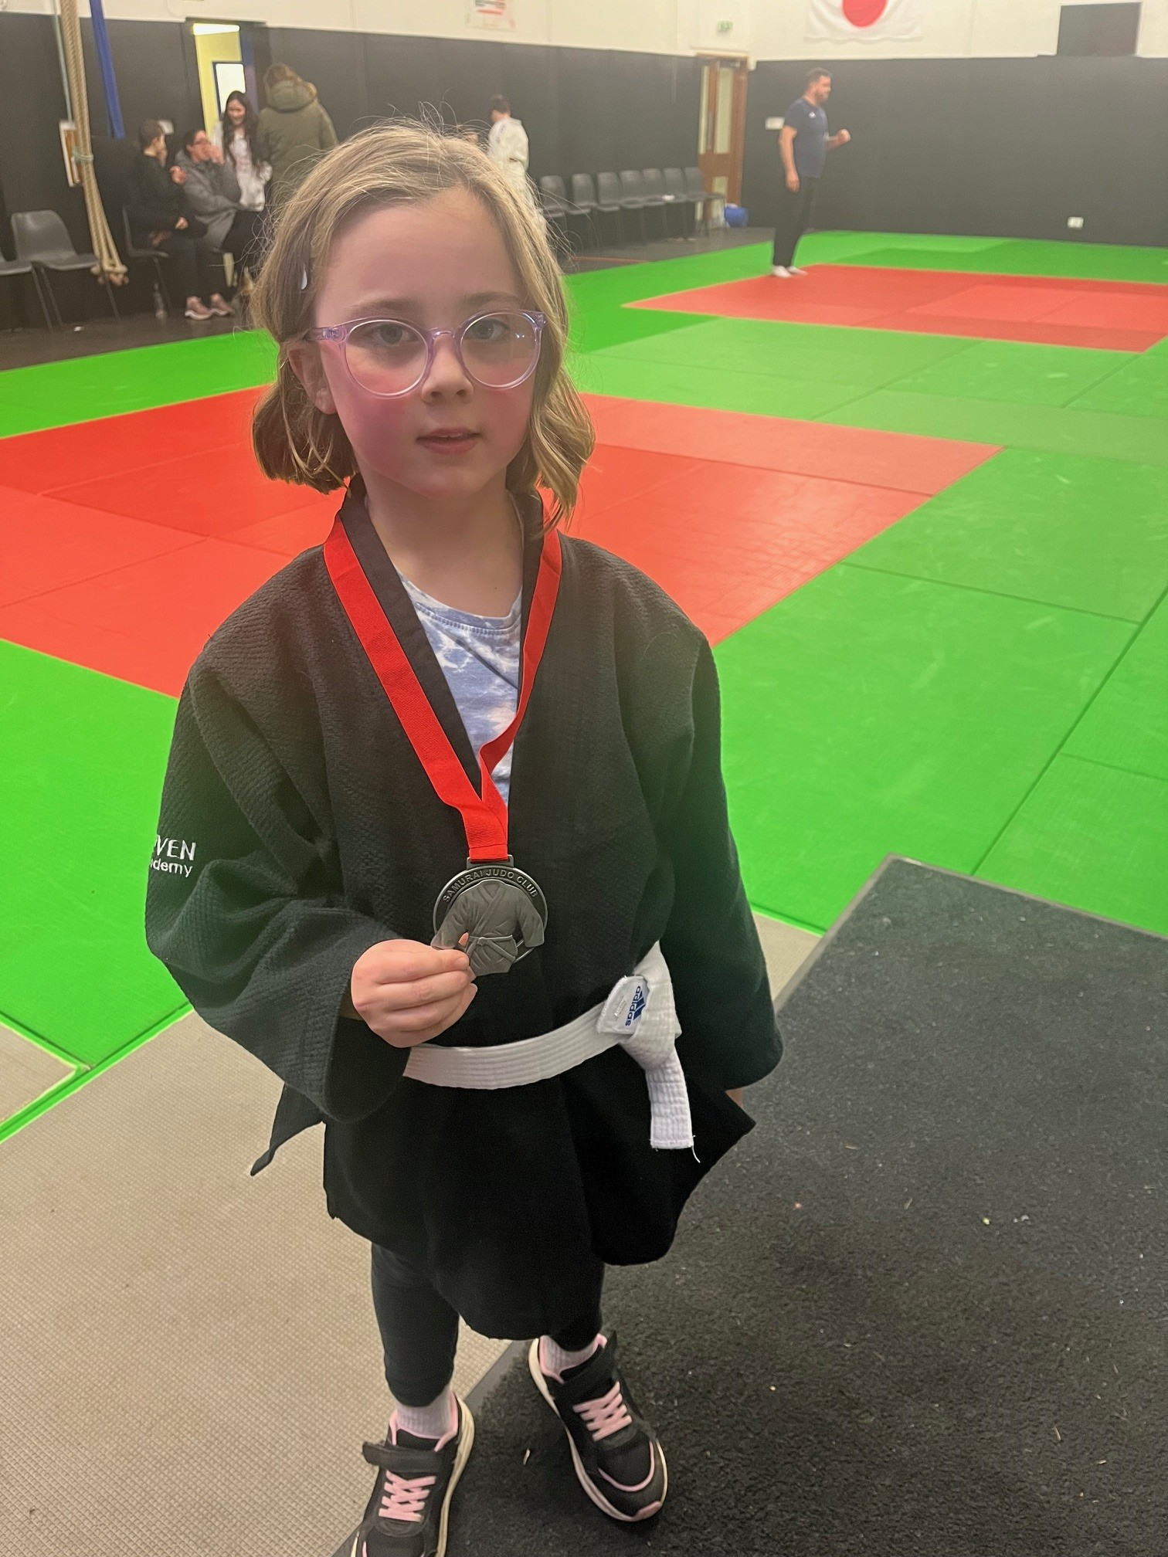
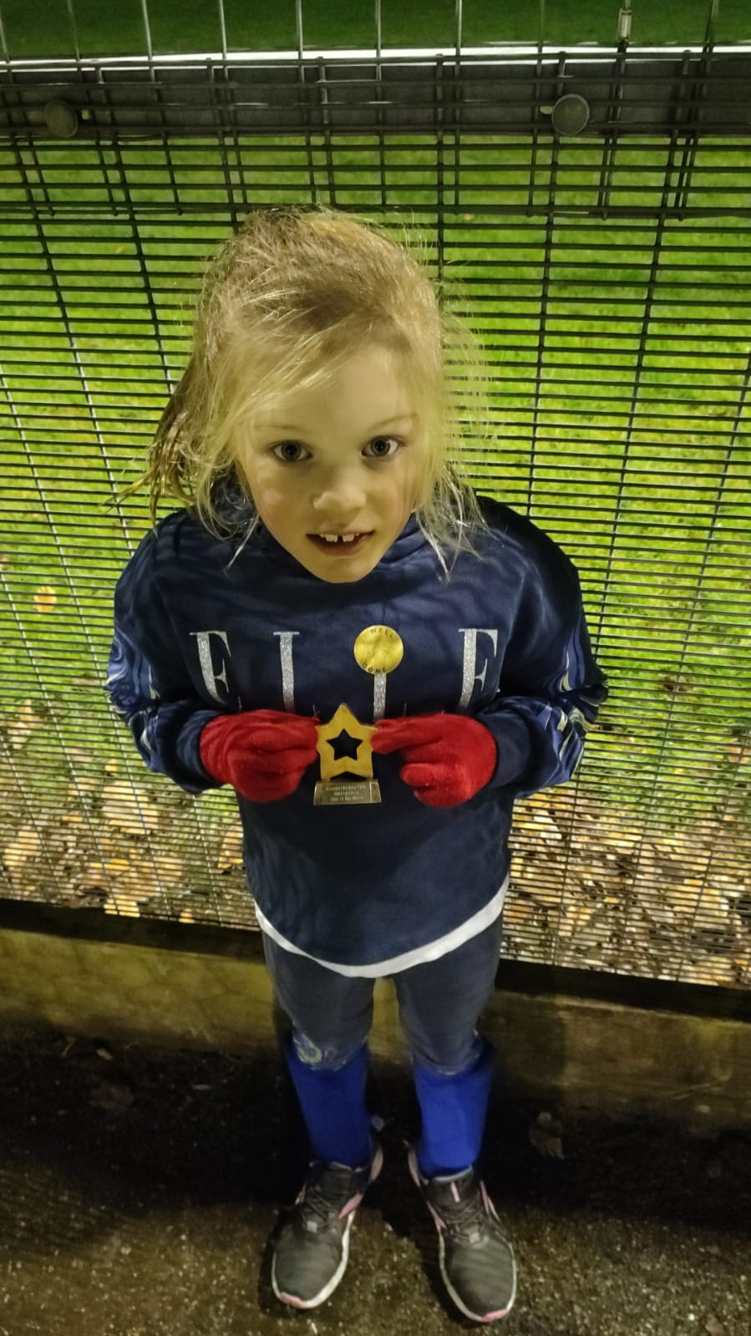



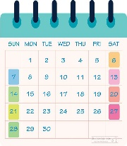
ACHIEVEMENTS OUTSIDE OF SCHOOL
If there is something you’d like to highlight and celebrate for your child. Please email admin@heronhill.cumbria.sch.uk with the subject ‘F.A.O Mrs Middleton – Newsletter’ to ensure your email makes its way to me.
NB: By submitting photographs, you are consenting to your child’s image being added onto the newsletter which is shared via ParentMail and online.
Lily N from Year 3 (Glaramara) just received ‘Player of the Week’ at her new Judo Club - Craven Judo Academy! This was awarded for being brave and attending the busiest session of the week where’s she was one of the newest on the mat! We’re very proud of her! Well done, Lily!
Georgia G from Y2 has recently been awarded ‘star of the week’ at Kendal Hockey club.
What a brilliant achievement – well done Georgia! Keep up the excellent effort with your hockey training.
SOCIAL MEDIA
It has been great to see parents interacting with our X page and keeping up to date with our school news feed. You can join in: follow @heronhillschool on the X platform/app.
For the latest information about our Christmas events, please see your separate email from Mrs Lehane. This was sent via ParentMail on Tuesday 26th November.
SCHOOL IS CLOSED ON MONDAY 6TH JANUARY TO PUPILS FOR STAFF TRAINING. PUPILS RETURN ON TUESDAY 7TH JANUARY 2025.
- RESPECT - RESPONSIBILITY - RELATIONSHIPS -

Slide 4

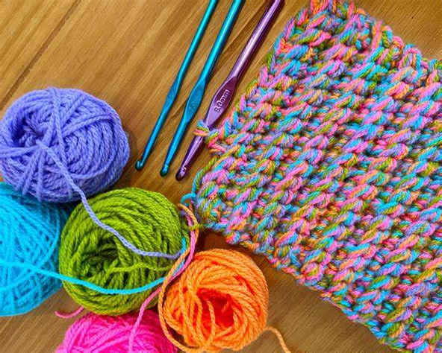
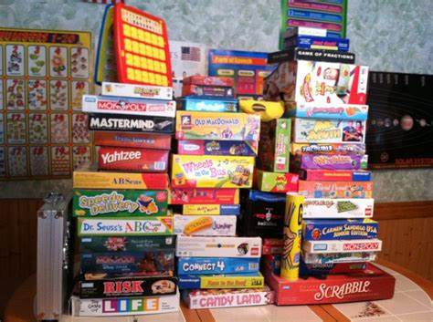
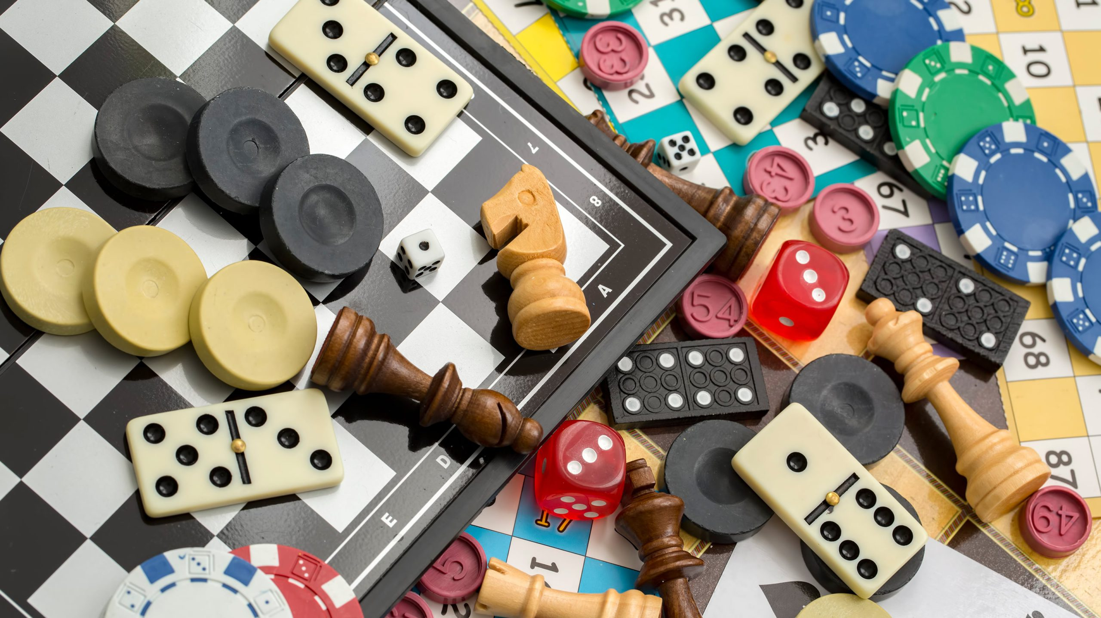
ATTENDANCE
Attendance to school is important for all pupils. Primary-aged pupils rely on adults to get them to school each day and on time. Please ensure you do all you can to get your child into school daily. If you are experiencing any challenges, please let a member of the senior leadership team know so that we can endeavour to help you.
OUR 8.45 AM STAGGERED DROP-OFF IS HAVING A REALLY POSITIVE IMPACT ON PUNCTUALITY EACH DAY. THANK YOU TO OUR PARENTS, CARERS AND FAMILY MEMBERS FOR EMBRACING THIS TRIAL CHANGE.
Remember: “Teachers close the door at 8.54!”
We have our first 100% week from a class in school this half term.
Well done to Catstycam class in Y5! Attendance superstars!
Registration Form | Class %
Reception - Latrigg | 88.5
Reception - Mellbreak | 92.0
Y1 Angletarn | 94.8
Y1 Whinlatter | 93.0
Y2 Outerside | 97.4
Y2 Yewbarrow | 90.7
Y3 Kentmere | 96.5
Y3 Glaramara | 87.3
Y4 Thornthwaite | 99.0
Y4 Blencathra | 96.1
Y5 Fairfield | 98.5
Y5 Catstycam | 100.0
Y6 Helvellyn | 96.3
Y6 Scafell | 97.0
RESOURCE REQUEST
Mrs Little and her lunchtime nurture club have been enjoying lots of different play and creative activities this term. As we approach Christmas and many families have clear-outs of unwanted toys etc., please consider donating any to school for nurture club to use. Mrs. Little also has some keen crochet creators who are running low on wool. If you have any lying around that you don’t need, they’ll happily take it off your hands. Thank you!
- RESPECT - RESPONSIBILITY - RELATIONSHIPS -

